Slide 1
POWER SYSTEMFAULT DETECTION and classification using machine learning
CAPSTONE PROJECT
Presented By:
Mohd Shahnawaz Ashraf Noida Institute of Engineering and Technology – CSE - AIML
GitHub Link - https://github.com/msaofficio/AICTE-AI-and-Cloud-Internship

Slide 2
OUTLINE
Problem Statement
Proposed System/Solution
System Development Approach
Algorithm & Deployment
Result
Conclusion
Future Scope
References

Slide 3
Problem Statement
Faults in power systems like Line-to-Ground (L-G), Line-to-Line (L-L), and 3-phase faults can damage equipment and cause blackouts. There is a need for a system that can automatically detect and classify these faults using voltage and current phasor data. The goal is to build a machine learning model to accurately identify fault types for maintaining grid stability.

Slide 4
Proposed Solution
The proposed system aims to address the challenge of detecting and classifying faults in a power distribution system using machine learning. The solution leverages voltage and current data to predict whether the system is operating normally or experiencing a specific type of fault. The system is designed to enable fast, accurate fault identification, enhancing the stability and reliability of the power grid.
Data Collection:
Use the publicly available dataset from Kaggle which includes labeled electrical measurements under different fault and normal operating conditions.
Focused columns include: Air temperature, Process temperature, Rotational speed, Torque, Tool wear, and Type.
Data Preprocessing:
Removed irrevelant columns from the dataset like Id’s and Names.
Performed data refinement using IBM Watsonx.ai Data Refinery
Machine Learning Algorithm:
Use IBM Watsonx.ai's AutoAI tool to automatically generate pipelines and selecting the best-performing pipeline (Snap Random Forest Classifier)
Multiple Algorithms evaluated including Decision Trees and Random Forest Classifier.
Deployment:
Use the Watsonx.ai interface to test the model with live inputs and visualize the prediction results.
Deploy the best model on IBM Cloud using the online deployment option. Expose REST API endpoints for real-time testing and predictions.
Evaluation:
Assess model performance based on accuracy, F1-score, precision, and recall. Top model achieved 99.4% accuracy with high precision across all classes.
Predictions successfully distinguish between “No Failure” and various fault types with high confidence.

Slide 5
System Approach
System requirements
A machine learning environment with support for AutoAI workflows
Cloud platform for model training, deployment, and testing (IBM Cloud Lite)
Tools for data refinement and visualization (Data Refinery)
Internet access for dataset retrieval from Kaggle
Library and Platform Stack:
Platform: IBM Watsonx.ai Studio
Model Builder: IBM AutoAI (AutoML tool within Watsonx.ai)
Data Refinement: IBM Data Refinery (within Watsonx.ai)
Deployment & Testing: IBM Cloud Deployment Space
Underlying Tech: Python-based ML backend using scikit-learn inside AutoAI

Slide 6
Algorithm & Deployment
Algorithm Selection:
The selected algorithm is the Snap Random Forest Classifier, automatically chosen by IBM Watsonx.ai AutoAI based on its superior accuracy and robustness. Random Forest was preferred due to its ability to handle high-dimensional input data and its proven effectiveness in multiclass classification problems like fault detection
Data Input:
The algorithm takes the following as the input – Type (String/Categorical), Air Temperature (Decimal), Process Temperature (Decimal), Rotational Speed (Integer), Torque [Nm] (Decimal), Tool Wear [min] (Integer).
Training Process:
The dataset was split into training and holdout sets using IBM AutoAI's default split. AutoAI automatically performed:
Feature Engineering
Hyperparameter Optimization
Model Selection using Cross-Validation
Each pipeline was built and validated independently, and the best-performing model was Pipeline 2 (Snap Random Forest Classifier) with cross-validated performance metrics.
Prediction Process:
In the test phase, the model correctly classified inputs with up to 100% confidence, demonstrating strong generalization.

Slide 7
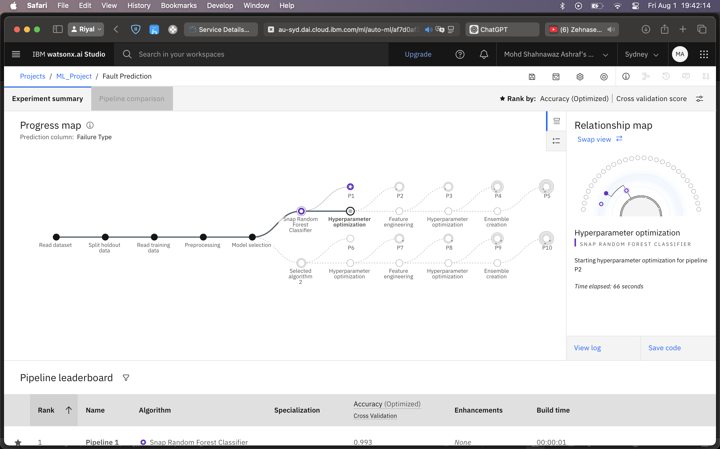
Algorithm & Deployment

Slide 8
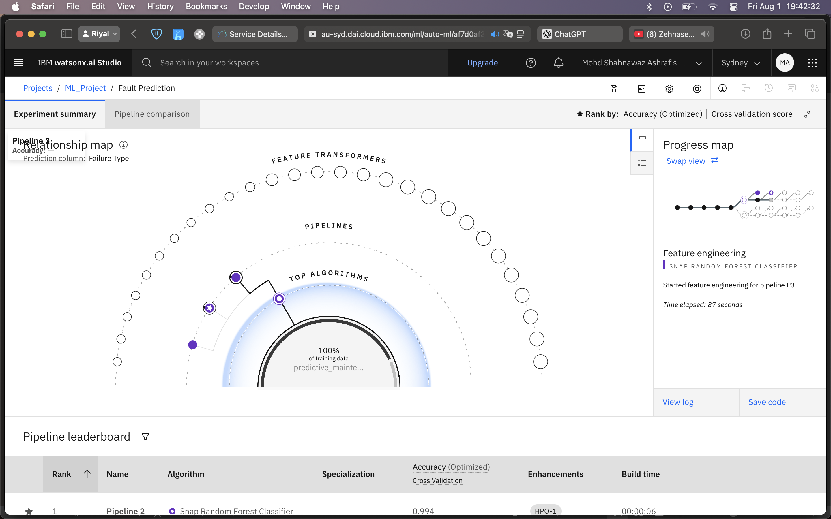
Algorithm & Deployment

Slide 9
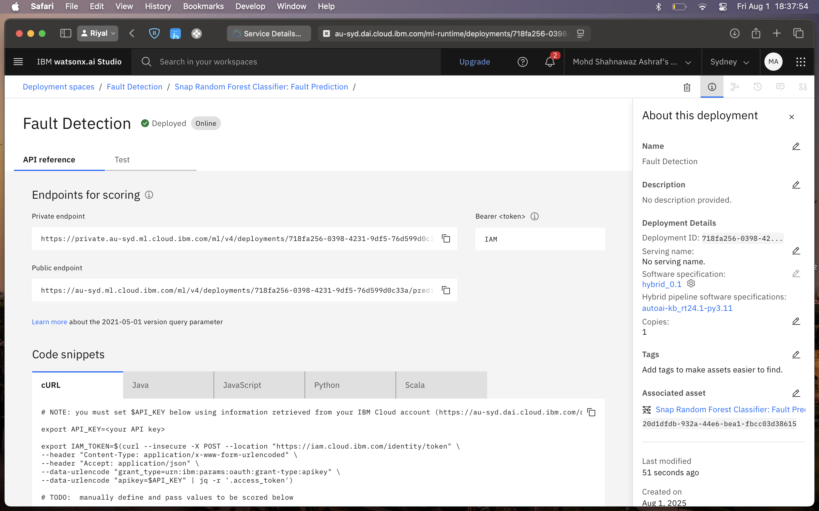
Algorithm & Deployment

Slide 10
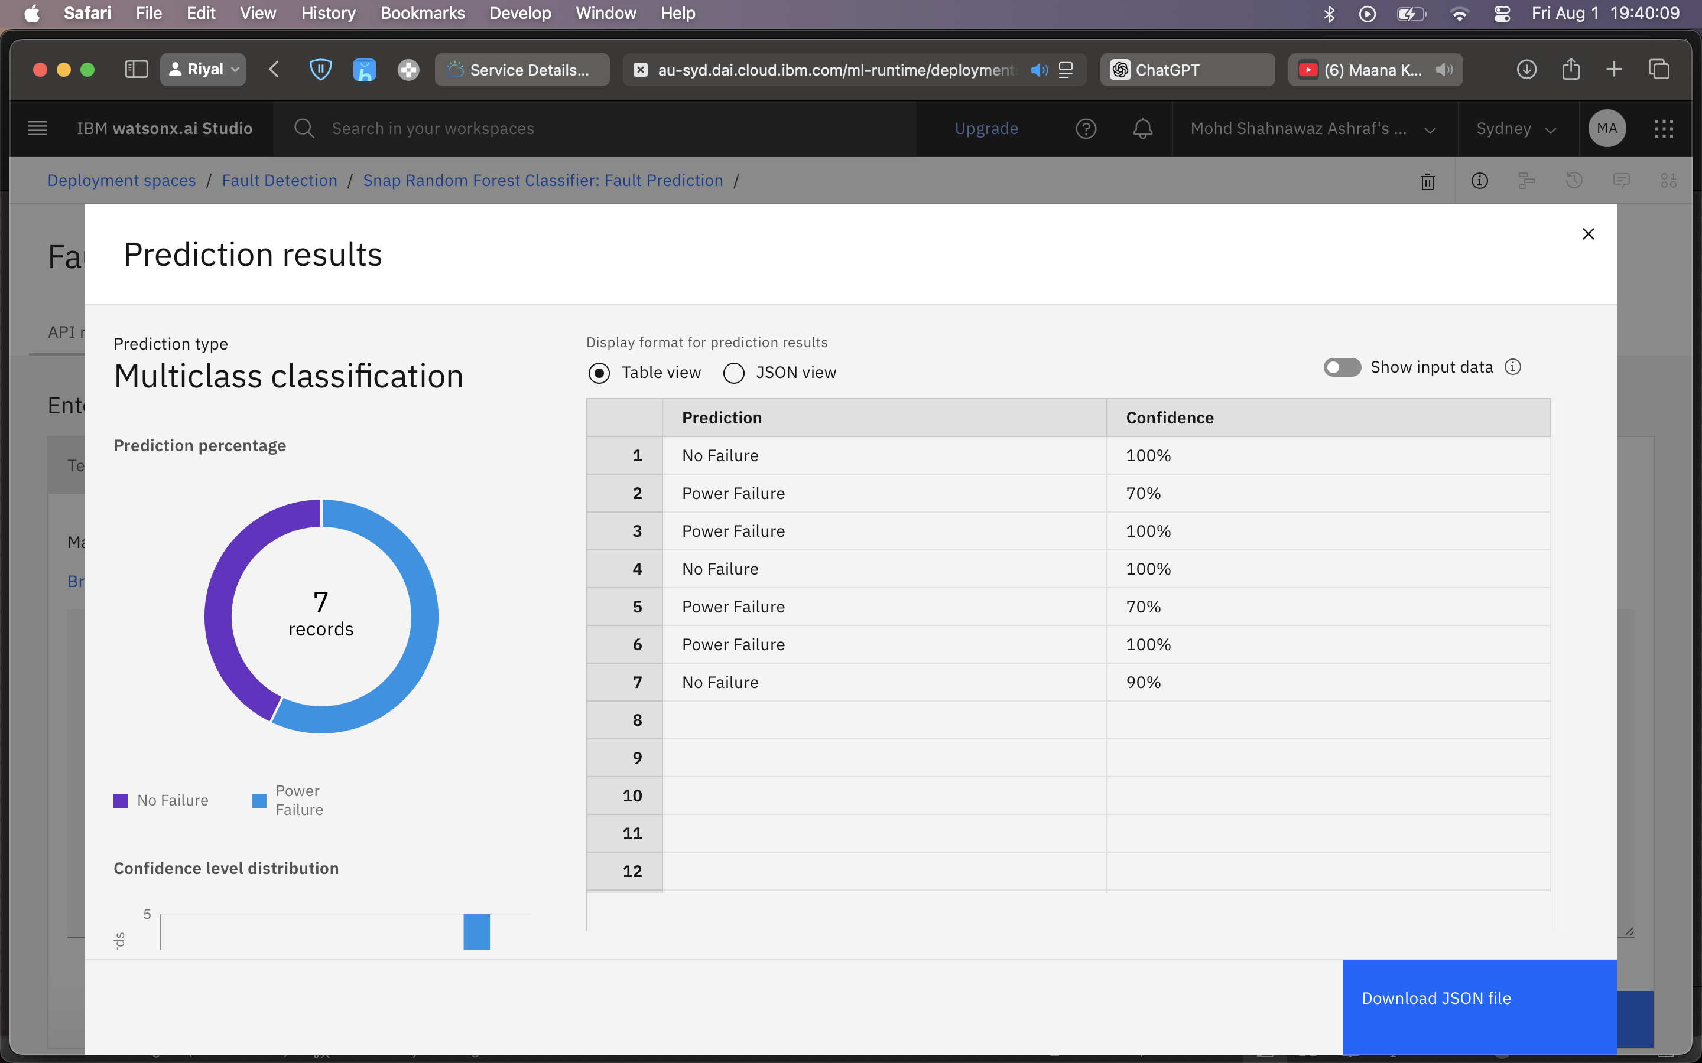
Result

Slide 11
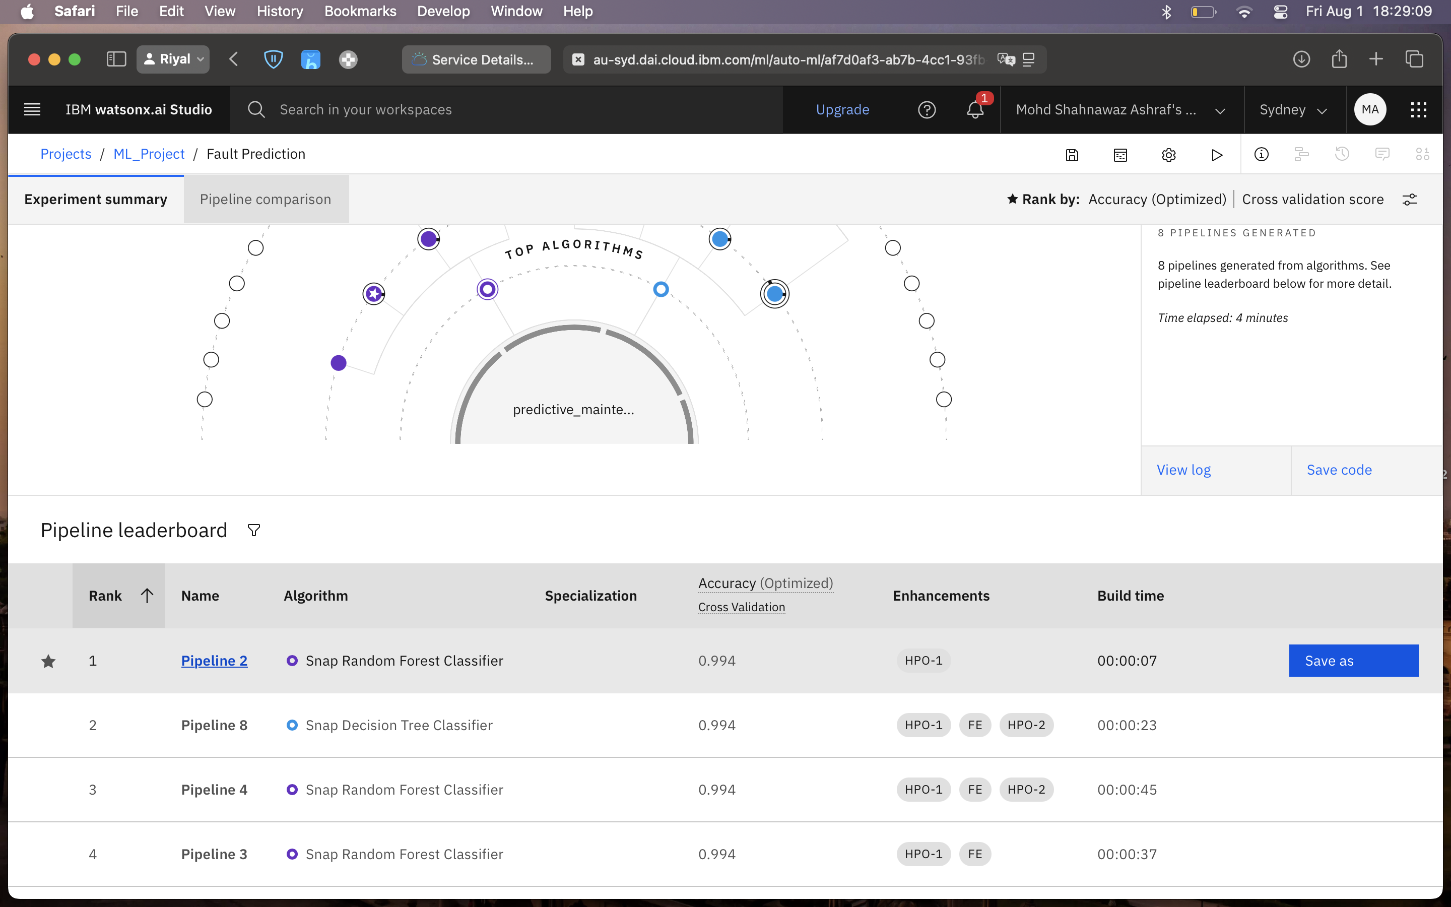
Result

Slide 12
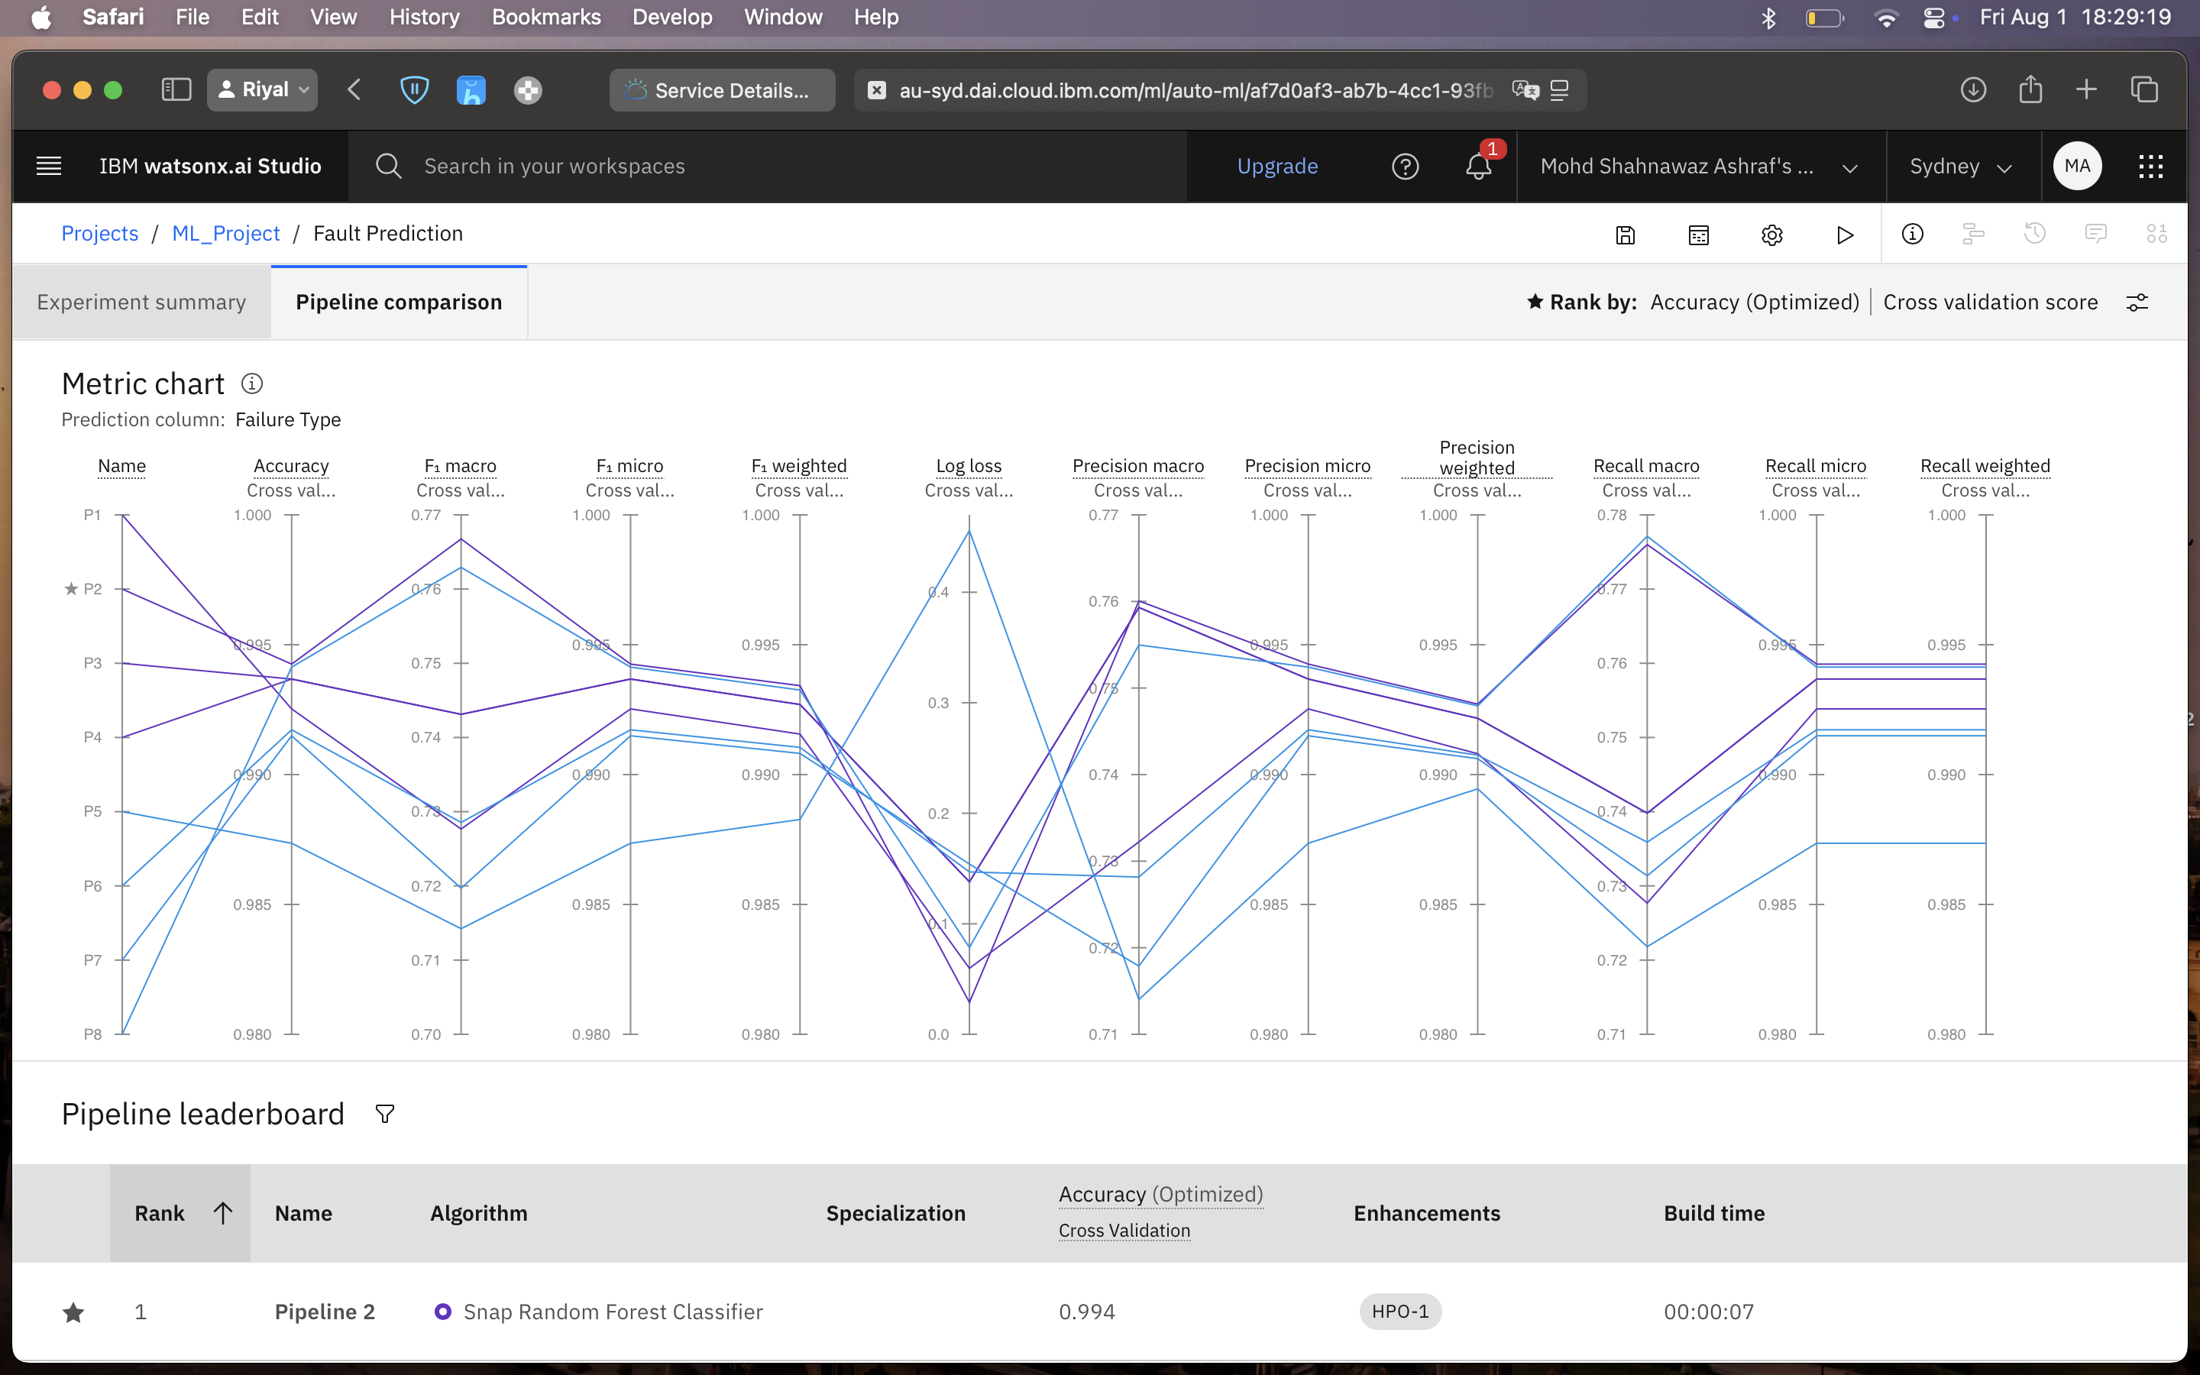
Result

Slide 13
Conclusion
The project successfully demonstrated the use of machine learning, specifically IBM Watsonx.ai’s AutoAI, for accurate and efficient classification of power system faults. By training the model on a labeled dataset of electrical parameters such as voltage, current, torque, and temperature, the system was able to distinguish between normal conditions and fault scenarios with a high degree of precision.
The proposed solution proved effective, with the best-performing model (Snap Random Forest Classifier) achieving 99.4% accuracy. This high accuracy enables near real-time identification of critical faults like Line-to-Ground or Power Failures, which is essential for maintaining power grid reliability and minimizing downtime.
Accurate fault detection is crucial in electrical systems, just as accurate bike count predictions are vital for managing urban transportation. This system demonstrates how AI can play a key role in creating smarter, more resilient power infrastructure.

Slide 14
Future scope
The system can be enhanced and expanded in several ways:
Real-Time Data Integration: Incorporate IoT sensor data from the grid for real-time fault detection.
Algorithm Improvements: Explore deep learning models like LSTM or ensemble methods for better accuracy.
Wider Deployment: Extend the model to support multiple regions or substations with different operating conditions.
Edge Computing: Deploy the model on edge devices for faster local predictions without relying on cloud latency.
Scalability: Integrate with dashboard tools for centralized fault monitoring across multiple sites.

Slide 15
References
Ziya Uddin (2020). Power System Faults Dataset – Kaggle. https://www.kaggle.com/datasets/ziya07/power-system-faults-dataset
IBM Watsonx.ai Documentation. Build, train, and deploy machine learning models using AutoAI. https://www.ibm.com/docs/en/watsonx
GitHub Link - https://github.com/msaofficio/AICTE-AI-and-Cloud-Internship

Slide 16
IBM Certifications

Slide 17
IBM Certifications

Slide 18
IBM Certifications

Slide 19
THANK YOU

